Slide 1
Monitoring points in the Dominican Republic for the IDB - update
Project Personnel :
Michael Gomez Selvaraj & team
Crops for Nutrition and Health
Phenomics Platform

Slide 2
Work plan schedules\Timeline
Goals | Month 1 |  |  |  | Month 2 |  |  |  | Month 3 |  |  |  | Month 4 |  |  |  | Month 5
 | 1 | 2 | 3 | 4 | 1 | 2 | 3 | 4 | 1 | 2 | 3 | 4 | 1 | 2 | 3 | 4 | 1 | 2 | 3 | 4
Development of the research concept and work plan
Identification of availability of satellite images for the study area and quality check
Progress report at the end of the first month
Data pre-processing, creation of IVs, extraction and analysis of features
Generation of trends for each crop with their respective IVs
Progress report at the end of the third month
Hedge usage change and trend analysis
Validation with 2014 and 2019 PATCA data
Preparation of the final technical report
Final report

Slide 3
Data Correction

Slide 4
Corrected IDB data
633 original data
4 data without coordinates
105 data with the same spatial point
73 data in rest field for 2011
Table 1. Number of points per crop
Crops | Count | Percent
Pasto | 143 | 32.87356
Rest field | 73 | 16.78161
Platano | 42 | 9.655172
Yuca | 25 | 5.747126
Maiz Grano/Mazorca | 14 | 3.218391
Habichuela Roja | 12 | 2.758621
Habichuela Negra | 11 | 2.528736
Aguacate | 11 | 2.528736
Limon | 10 | 2.298851
Cafe | 10 | 2.298851
Guineo | 8 | 1.83908
Guandul | 8 | 1.83908
Batata | 8 | 1.83908
Tabaco | 6 | 1.37931
Mango | 6 | 1.37931
Cebolla | 5 | 1.149425
Table 2. Number of points for correcting
Table 3. Number of points for corrected
Point type | Count | Percent*
Move | 213 | 48.88
Checking area | 122 | 28.04
Over road | 98 | 22.52
Move and road | 74 | 17
OK | 73 | 16.78
Point type | Count | Percent*
ok | 100 | 22.99
Moved | 278 | 63.9
Influence area | 99 | 22.75
not enough area | 58 | 10.34
* total data is 435 points
* total data is 435 points
With these corrections, in total are 377 points for the study

Slide 5
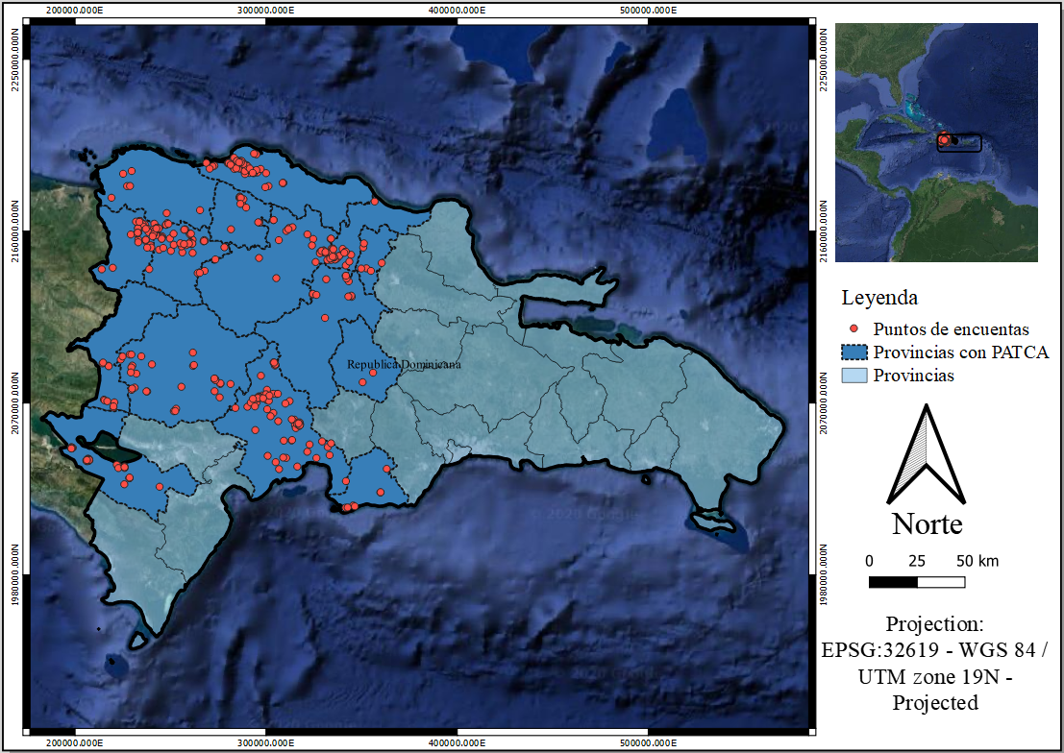
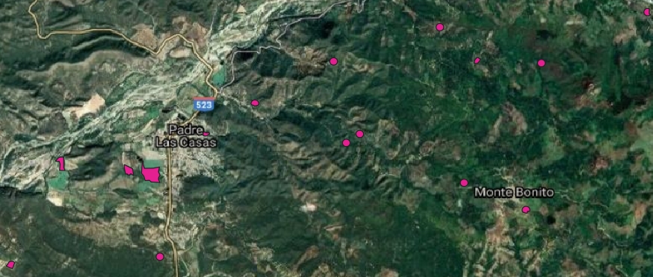
Corrected IDB data
polygons
points
Table 3. Number of points for PATCA
PATCA | Count | Percent*
0 | 248 | 65.78
1 | 129 | 34.21
* total data is 377 points

Slide 6
Methodology Search

Slide 7
Trends and Change-Point Detection Methods for Remote Sensing Data
Methods
Trends Detection
Change point detection
Mann-Kendall
Cox-Stuart
Non-parametric
parametric
Regression-based
Modified Mann-Kendall
LandTrendr
CCDC
Buishand range
Struccchange
E.divisive
Buishand U
BFAST
Snh
Meanvar

Slide 8
Trends and Change-Point Detection Methods for Remote Sensing Data
Methods
Trends Detection
Change point detection
Mann-Kendall
Cox-Stuart
Non-parametric
parametric
Regression-based
Modified Mann-Kendall
LandTrendr
CCDC
Buishand range
Struccchange
E.divisive
Buishand U
BFAST
Snh
Meanvar

Slide 9
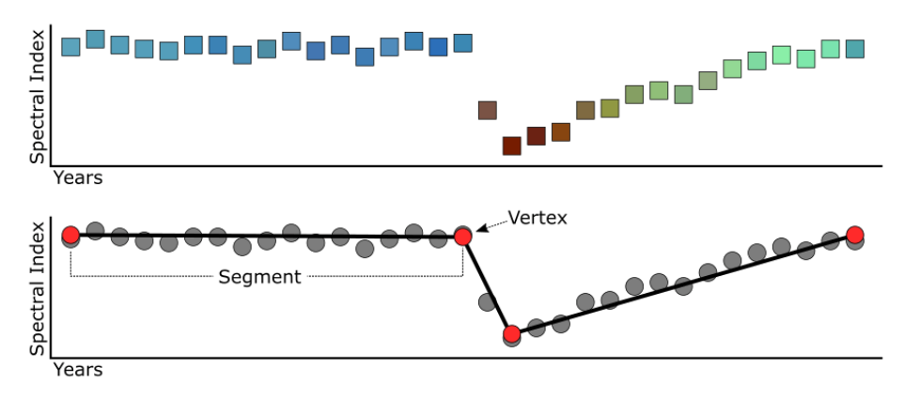
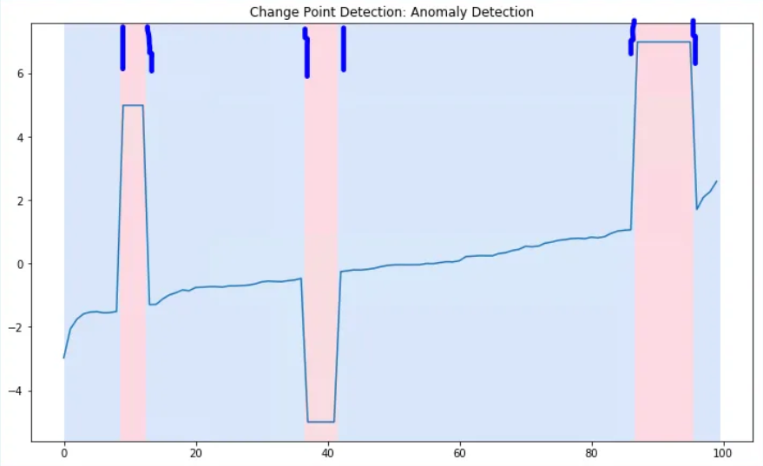
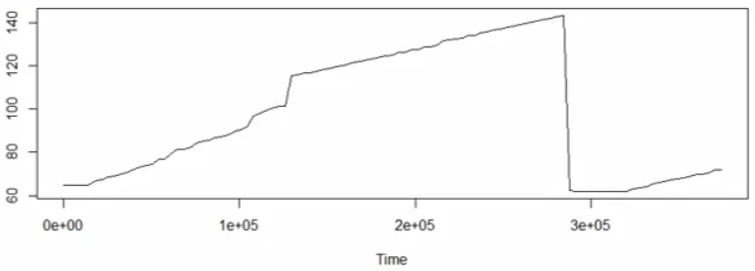
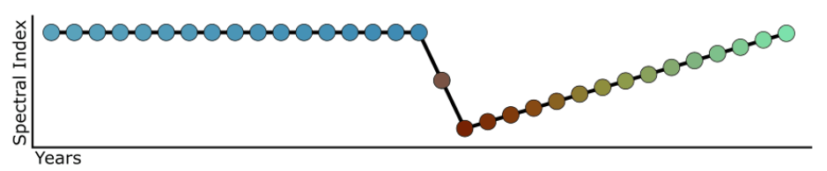
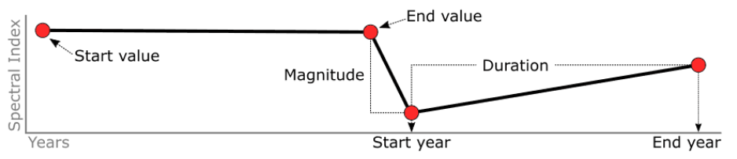
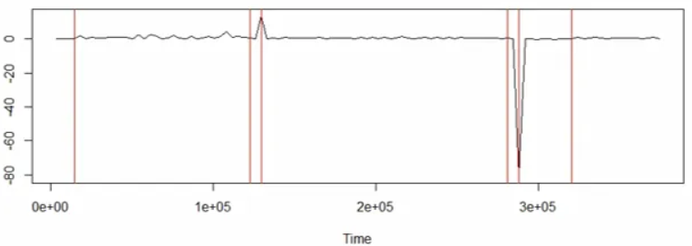
Trend and Change-Point Detection Methods for Remote Sensing Data
Trends
Change point detection

Slide 10
Image Collection, Corrections and Methodology

Slide 11
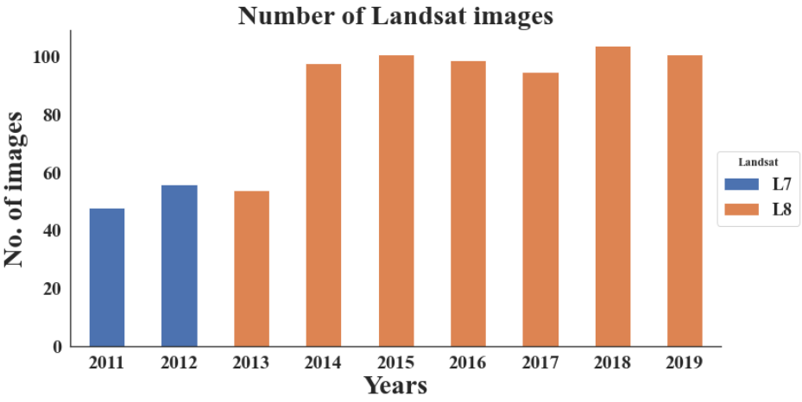
Frequency of Satellite Images used in this study
Total = 882 images

Slide 12
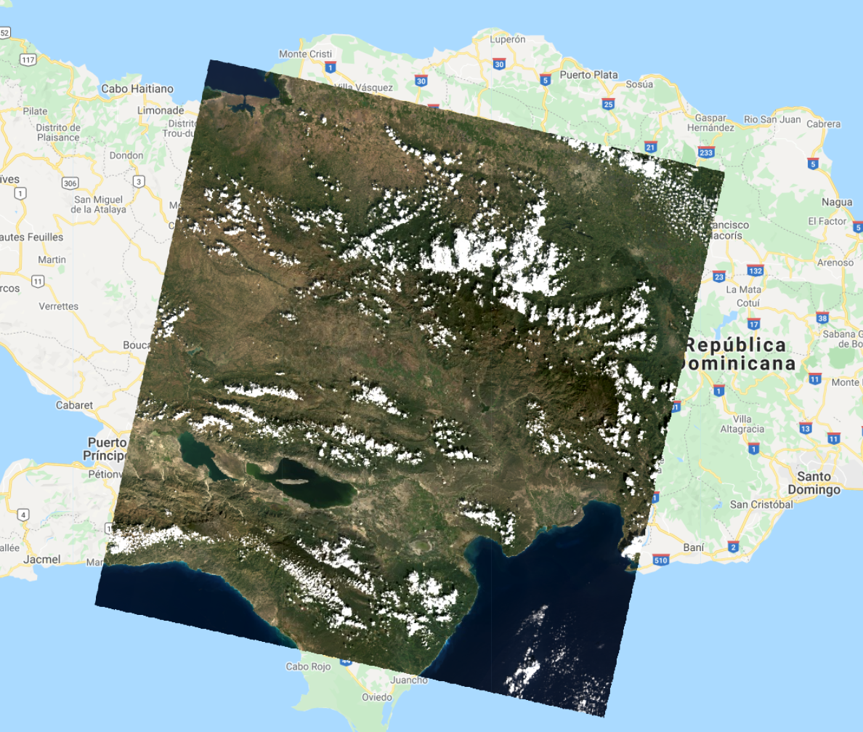
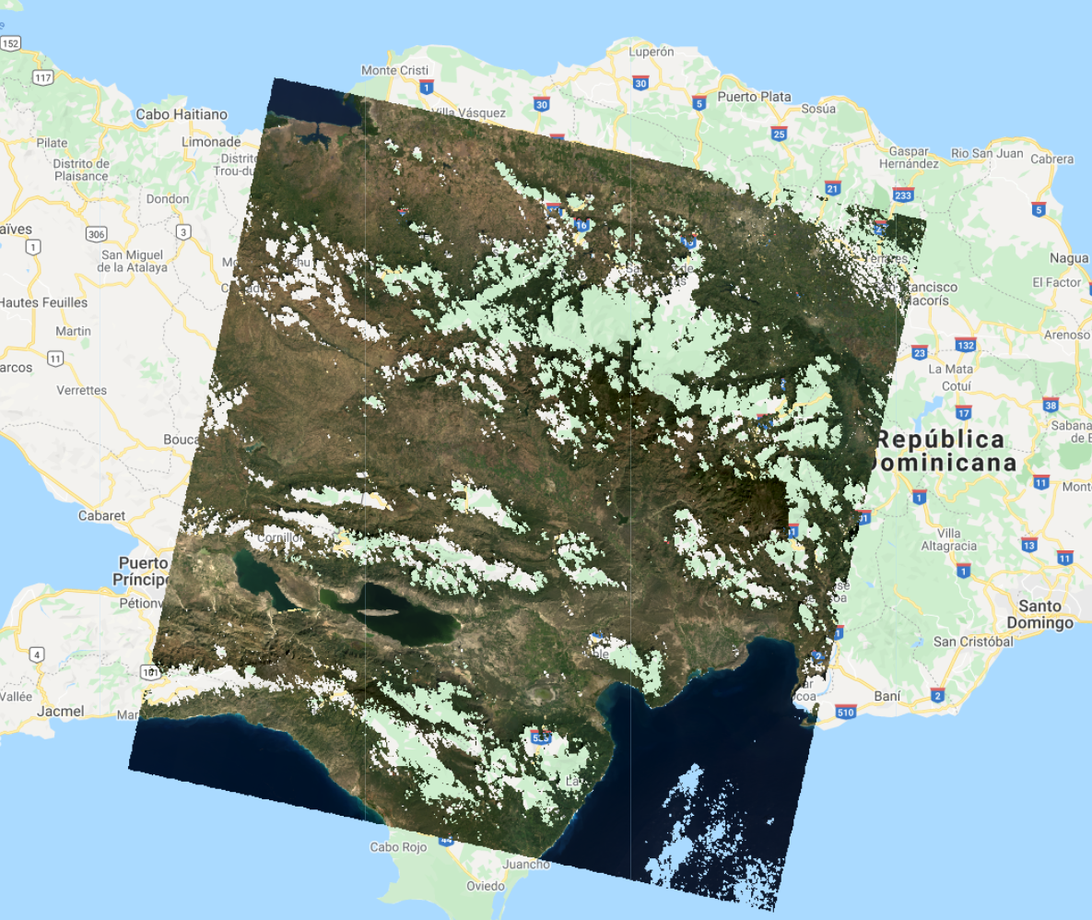
Images corrections
Cloud Mask

Slide 13
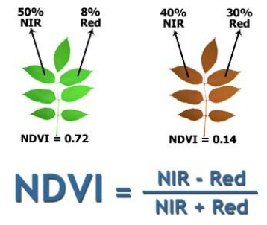
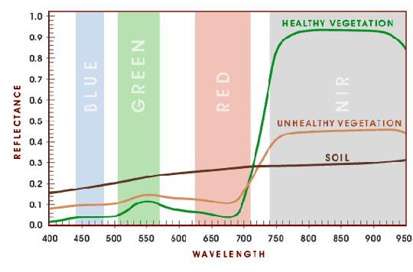
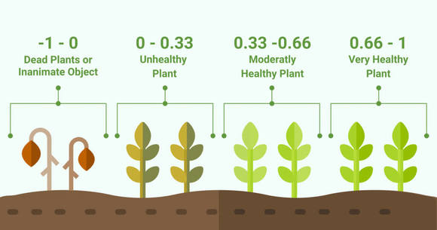
The Power of Vegetation Index

Slide 14
Methodology
Colección de datos
Imágenes 2011 - 2019
Encuesta PATCA 2011-2019
Pre-proceso imágenes
correcion datos 2011 - línea base
Procesamiento de imágenes
Mascara de nubes
Datos de tierra
Recorte zona estudio
Creación índices
Comparación 2014 - 2019
Extracción de características
Métodos de tendencias y DPC*
Validación
Resultados de tendencias y DPC
*DPC: Detección de puntos de cambio

Slide 15
Graph trends 2011 – 2019 with pacta

Slide 16
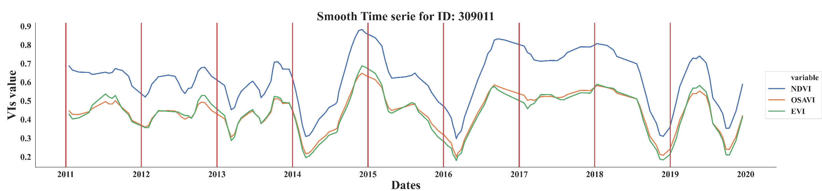
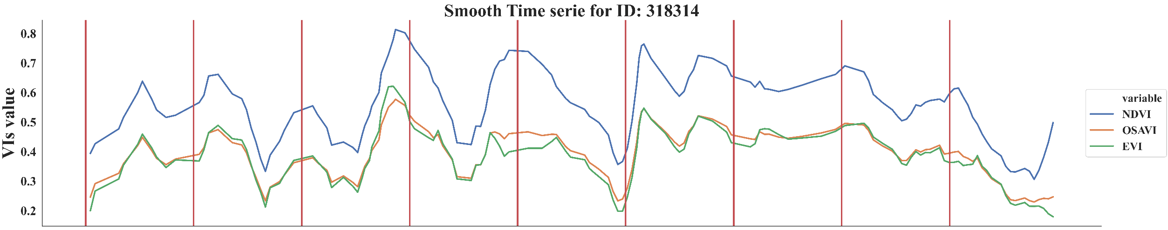
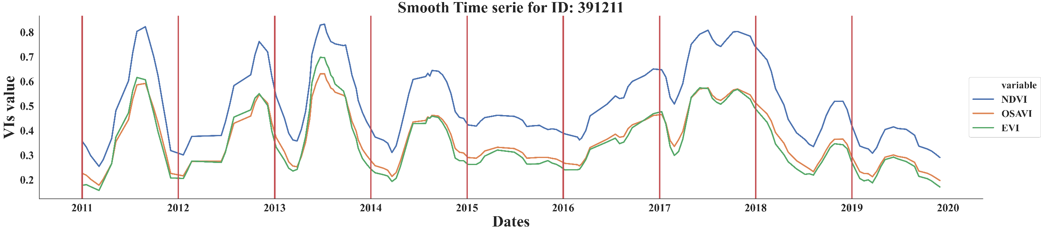
Trends for Patca = 1
Temporary=0
Temporary=0
descanso
Guineo
Temporary=1
Temporary=0
aji
pasto
Temporary=0
Temporary=0
Arboles maderables
aguacate

Slide 17
Graph trends 2011 – 2019 without pacta

Slide 18
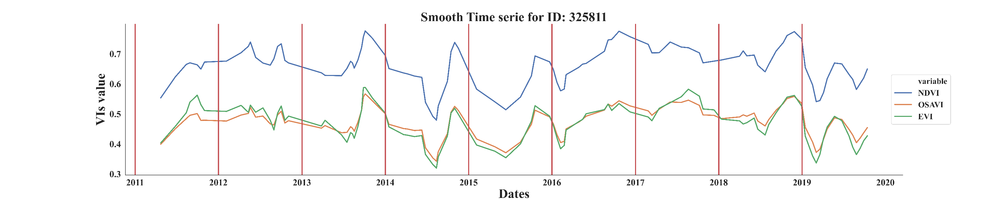
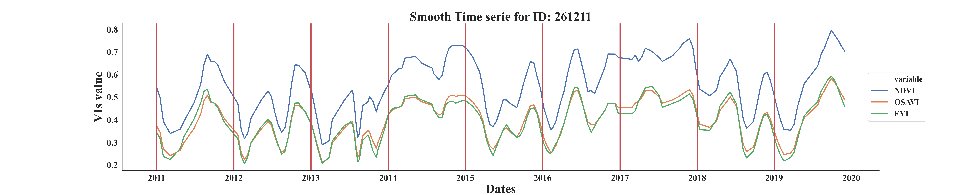
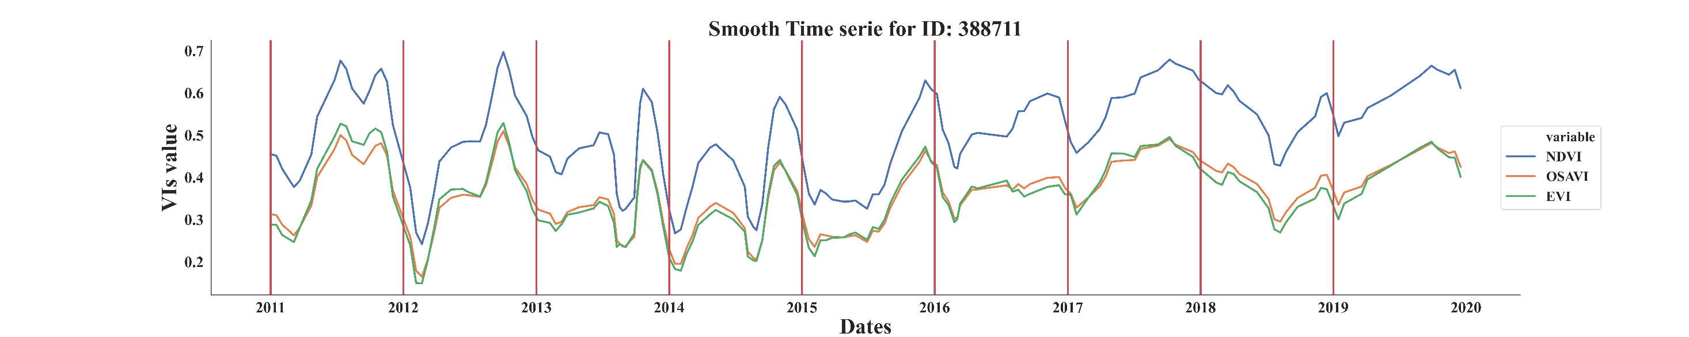
Trends for Patca = 0
Temporary=0
Temporary=0
pasto
Gineo
Temporary=1
Temporary=0
yuca
pasto
Temporary=1
Temporary=1
cebolla
habichuela

Slide 19
Results of Developed Models

Slide 20
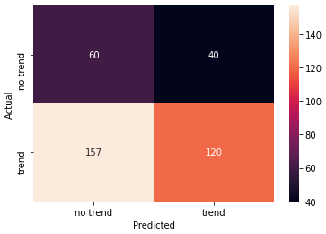
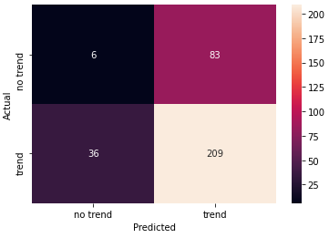
Accuracy Matrix of 2014
Confusion matrix from MK
Confusion matrix from CCDC
Method | Mann Kendal | CCDC
Accuracy | 45% | 71%
Overall accuracy is around 71% to detect the changes,
the accuracy was little low due to low amount of ground-truth data
and in accurate GPS points

Slide 21
Patca vs no Pacta

Slide 22
Patca vs No Patca
Patca | temporary crop | NDVI | OSAVI | EVI
0 | 0 | 0.559 | 0.392 | 0.384
 | 1 | 0.575 | 0.392 | 0.379
1 | 0 | 0.600 | 0.415 | 0.403
 | 1 | 0.558 | 0.383 | 0.365
Mean 2011 to 2014 of vegetation indices by Patca and temporary crop

Slide 23
Products from this Projects :
Standardizing best remote sensing methods to detect changes in land use exploiting time series satellite images.
The time series based trends and no trends change detection in each pacta data points with overall 71% prediction rate.

Slide 24
Current and Future Directions
Survey based Image supported method
Current work
Field | 2011 | Prediction | 2014
Field 1 | 0 transitory | Change | 1 permanent
Field 2 | 0 transitory | Change | 1 permanent
Field 3 | 1 permanent | Non change | 1 permanent
71% Change detection accuracy
Future :
Fully Automatic Image based methods
Image based
Permanent
Temporary
Permanent
Permanent
Future direction

Slide 25
Future research to focus :
More accurate survey using GPS.
Developing machine learning (ML)/non ML models to detecting temporary and permanent crop by more frequent time series images using automatic methods like segmentation ML algorithms.
Exploiting medium and high resolution satellite data to get good resolution for better prediction.
Implement NDWI for monitoring farmers with Pacta
Monitoring farmers with Pacta before and after the implementation of technology

Slide 26
Thank you

Slide 27
Monitoring points in the Dominican Republic for the IDB - update
Project Personnel :
Michael Gomez Selvaraj & team
Crops for Nutrition and Health
Phenomics Platform

